Slide 1
Requirements Engineering: “Happy Little Accidents”
Brainstorm Consulting
Notes:
Hello, we are Brainstorm consulting, Our project is to create a Mobile Ordering System for the best seng painting company.
We will discuss evolution of our project and highlight some of the more interesting things we learned about RE.

Slide 2
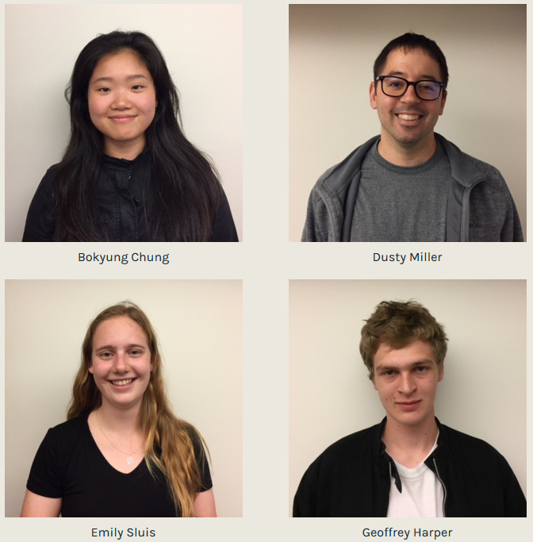
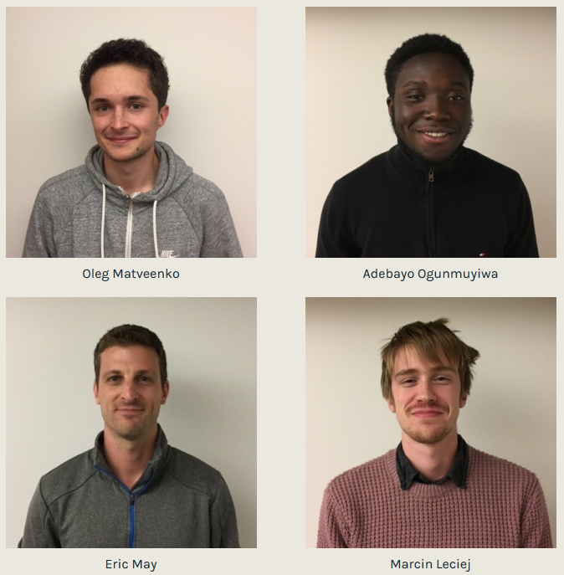
Our Team
Notes:
This is our team, ...
To give you a better understanding of the problem space and our product Bo will do a walkthrough of our UI

Slide 3
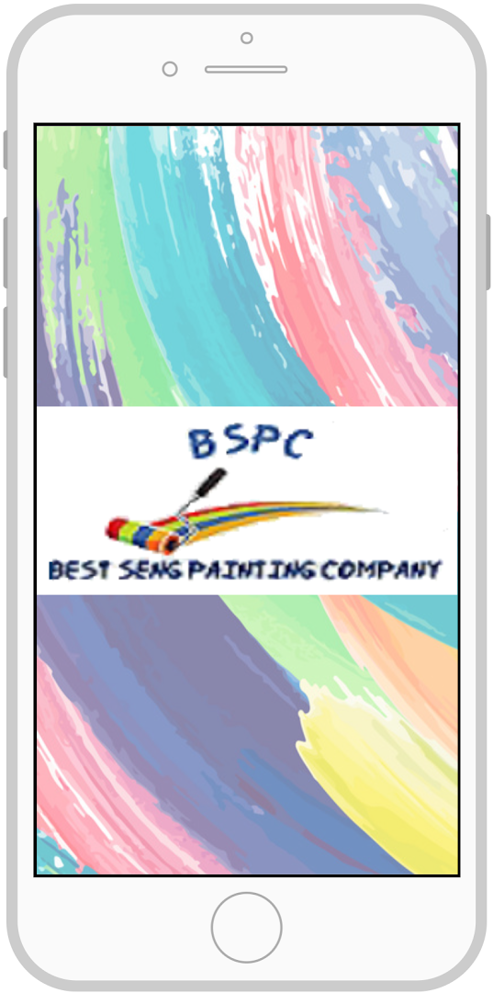
UI Prototype Demonstration

Slide 4
Evolution of System Features
Mobile Ordering System
Notes:
The evolution of system features
(transition from bo’s part)
Over the course of this project, unsurprisingly the content in our documents changed. Most of the features were initially drastically different from the version that bo just showed you. But what did surprised me, was how much our understanding of both the problem domain and requirements engineering changed throughout the process.
To give you an understanding of what I mean, we’re going to give you a few examples of features, what we learned from them and how our use of RE methods evolved over time.

Slide 5
Requirement to Functionality
Case Study: Store Locator
Notes:
(Starting with the store locator. This feature didn’t actually exist in our first drafts. )

Slide 6
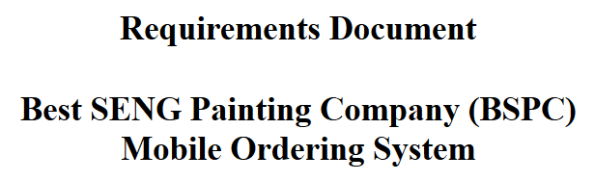
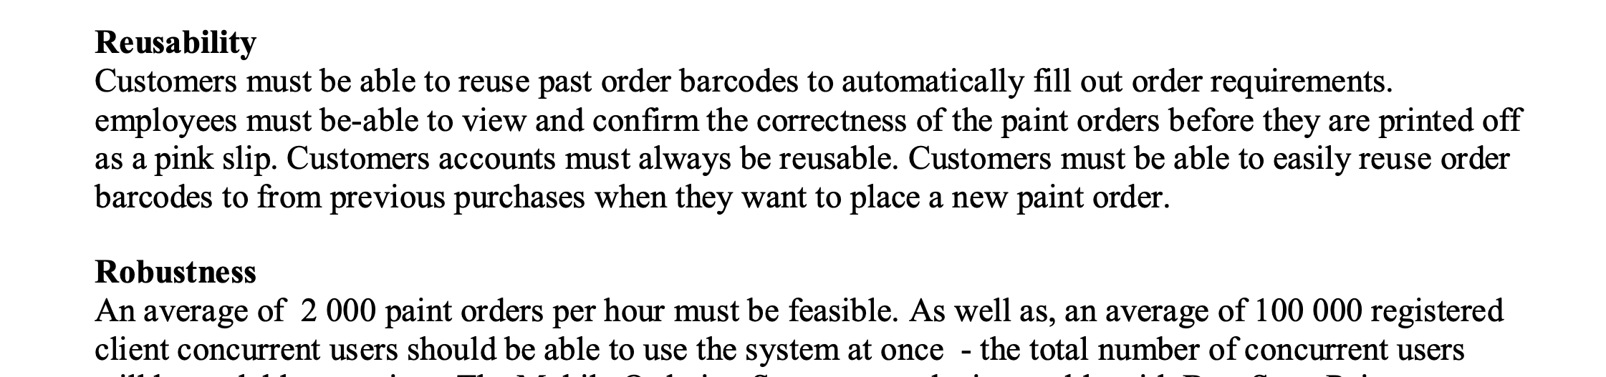
(Mis)understanding
Notes:
Based of our understanding of the RFP and initial elicitation, we envisioned a system that utilized barcodes and scanners, and integrated with BSPC’s point of sale system.
Our second elicitation could be described as a bombshell. This was the step were we really learned the importance of properly understanding the requirements and the implications of being unaware of Tacit knowledge
When we sat down with our client, we realized we had unknowingly made a rather large assumption.
( HAND OFF)
Our features didn’t sit right with the client, and it turned out that we believed we were designing a system for a single store in a single location

Slide 7
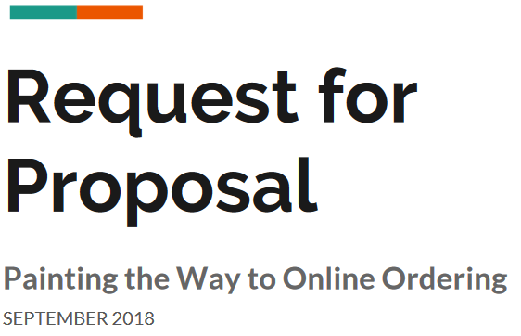
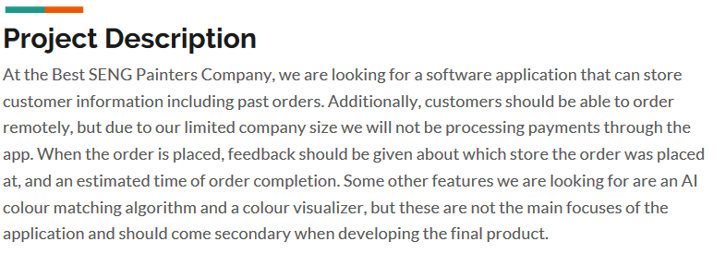
Elicitation
Notes:
This impacted every feature in the mobile ordering system. We had to make changes ranging from simply scaling the number of potential accounts active at any given time, to creating a new feature to find the nearest store to the customer, the Store Locator.
Following that meeting, we went back through the RFP and found this line that reads “when the order is placed, feedback should be given about which store the order was placed at”. (add sentence)

Slide 8
Lessons Learned
Implicit and tacit Information
Missing elements are the hardest to catch
Attention to detail
Store Locator
Notes:
Overall I’m glad we had this mix up towards the start because it improved the communication between us and the client. We learned that the client has implicit and tacit knowledge that needs to become explicit. You may think you’re talking about the same scope but without asking, you’ll never actually know.
Finding an issue within the current document is easy but catching an element that is missing all together is much more difficult. To prevent this, we worked on asking questions when they seemed obvious, trying to avoid making assumptions, and stating those assumptions when needed.

Slide 9
Requirement to Functionality
Case Study: Search feature

Slide 10
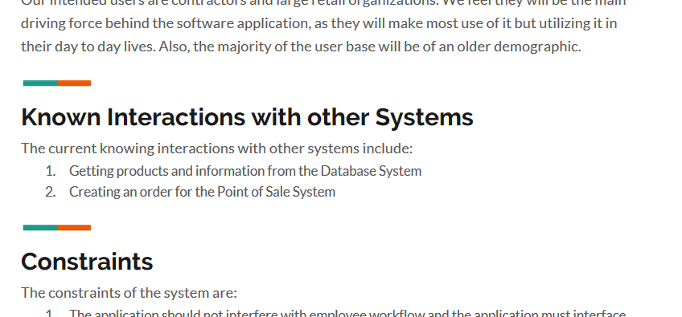
Feature De-evolution
Notes:
Interesting example of de-evolution
From RFP client required a way to access DB information directly
NEXT->

Slide 11
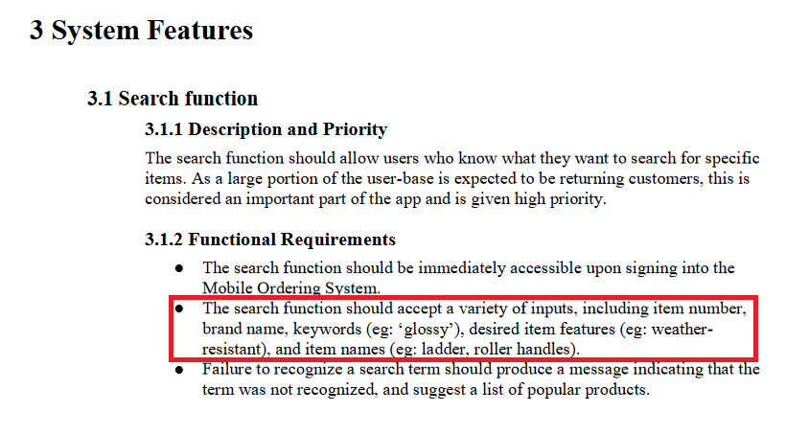
Powerful Search
Search was initially very powerful:
Search for other products
Search by specific feature(s)
Search by brands
Search by keywords
We expected search to be the most used feature.
Notes:
As CS/SENG students, we immediately wanted to build a strong search tool
Powerful, accept many types of input
Expected it to be most-used feature
NEXT->

Slide 12
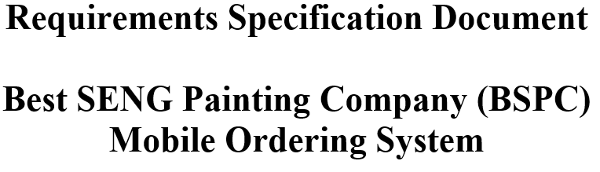
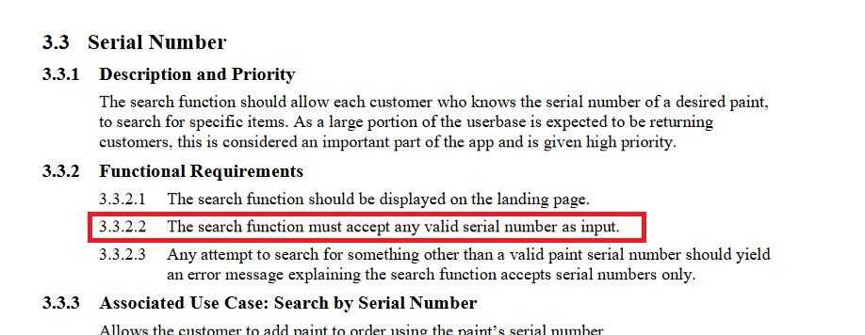
Restricted Search
RSD 0.9
Search now only accepts valid serial numbers.
Notes:
RSD: Only accepts valid serial numbers
Advanced search was scrapped, despite seeming like a killer feature
Why? Handover to Client
NEXT ->

Slide 13
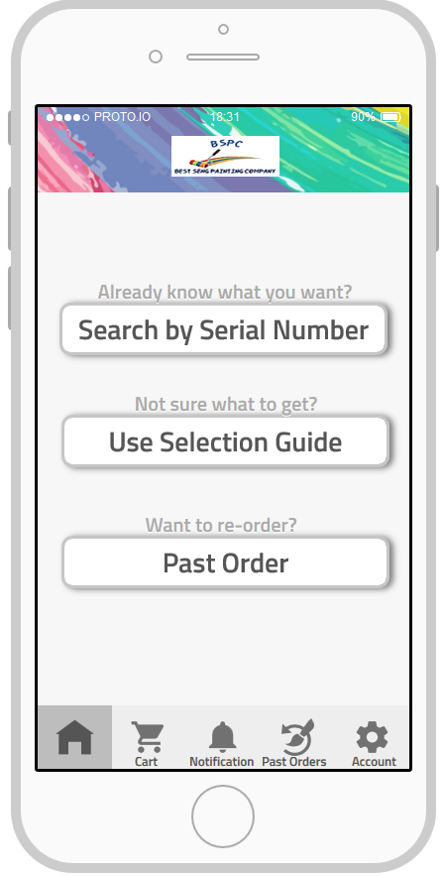
Problem Domain
Multiple stores have inconsistent inventory of accessories
House-brand paint only
Customers don’t know what they want
Weakened search encourages use of selection guide
Notes:
-Have this up while Client talks
-Making search more appealing would lead to Selection guide being used less
-Want to encourage use of selection
NEXT ->

Slide 14
Lessons Learned
‘Better’ isn’t always better
Client knows the problem domain better than the developer does.
Search by Serial Number

Slide 15
Requirement to Functionality
Case Study: Product Comparison

Slide 16
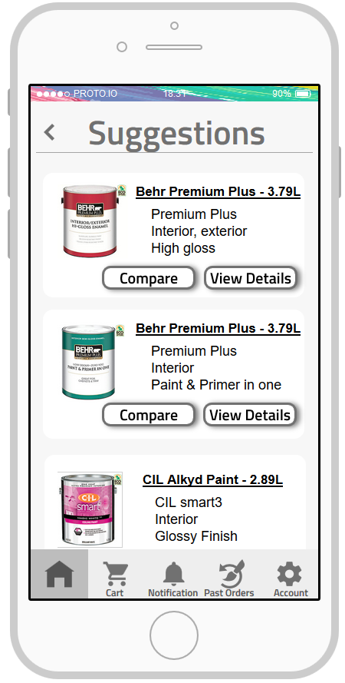
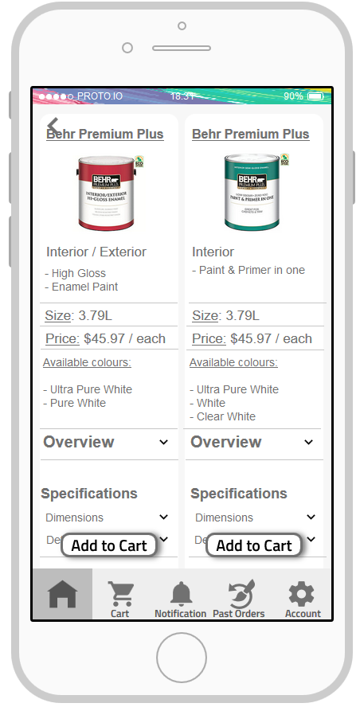
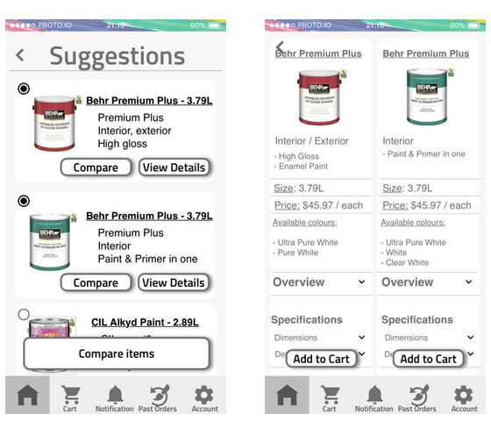
Simple User Interface
Product Comparison
Customers can easily compare by simply clicking the compare button
An easy to read side by side table is shown
Notes:
One of the main goal of this system feature is to continually build product knowledge and enable customers become familiar with several products thus becoming expert users through the cause of time. We aimed to do that by designing a clear and detailed User Interface.

Slide 17
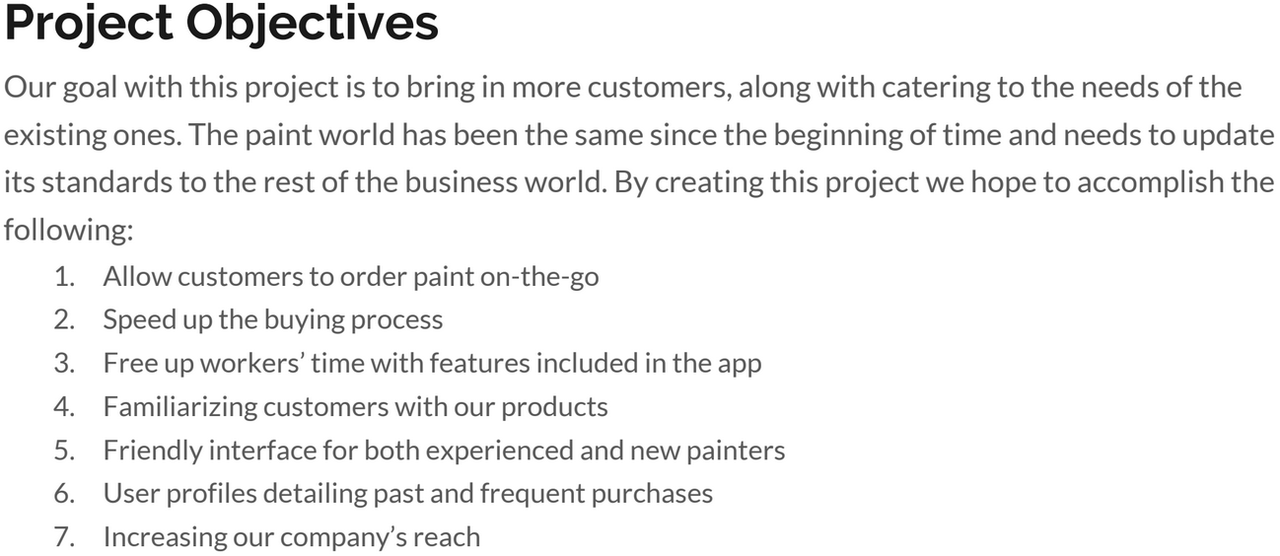
Flow of events
Initial read through of RFP
Omission and priority
Scope of feature
Initial idea was colour matching
Rational
Notes:
As developers on of our major struggle is over complexity :
During our first read through of the RFP, we experienced subconscious disambiguation with the project objectives as to fulfilling the clients objectives.
We initially designed a color matching feature with the aim of familizing customers with products, however they were some hardware constraints and as we will see it was out of scope and not with the clients requirements.
Our interpretation was to build a colour matching feature , with the aim of satisfying these requirements, however this was not clients requirme

Slide 18
Determining the Scope
Concept of system features
Feature never made it through discussion phase, Was never included in our release.
RFP
Second client meeting
RSD 0.9
First client meeting
Third client meeting
RD 1.0
RSD 1.0
Feature was discussed and labeled Low priority.( Analysis )
Feedback from client led to clarity of priority.
System feature included in doc,
The image shows a timeline of events that led to identifying the clients requirement and system feature.
Notes:
Upon our review of our 1st and 2nd client elicitation meetings, we streamlined our technique of negotiation and focused more on current system features, this led to the client identifying the missing requirement and highlighting a system feature that was out of scope.
Ideas usually require flushing out : Agile scrum is key :
Agile manifesto talks about our problems : Individuals and interactions OVER processes and tools
Customer collaboration
Responding to change OVER following a plan
Scrum is an agile framework which emphasizes on reducing the complexity to focus on building products that meet business needs.
Management framework for incremental product development
Self-organizing, cross-functional teams
Product progresses in a series of two- to four-week (fixed length) iterations: sprints
Every iteration produces a potentially shippable (properly tested but not complete) product
Requirements are captured as items in a list: product backlog

Slide 19
Lessons
Learned
Clarity to clients priorities
Improved communication during client meeting
Importance of a software process model
Product Comparison
Notes:
Agile manifesto talks about our problems : Individuals and interactions OVER processes and tools
Customer collaboration
Responding to change OVER following a plan

Slide 20
Requirement to Functionality
Case Study: Selection guide
Notes:
The Selection guide feature was an example of the RE workflow going as expected

Slide 21
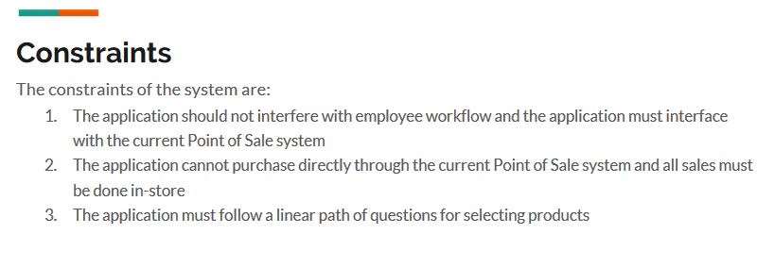
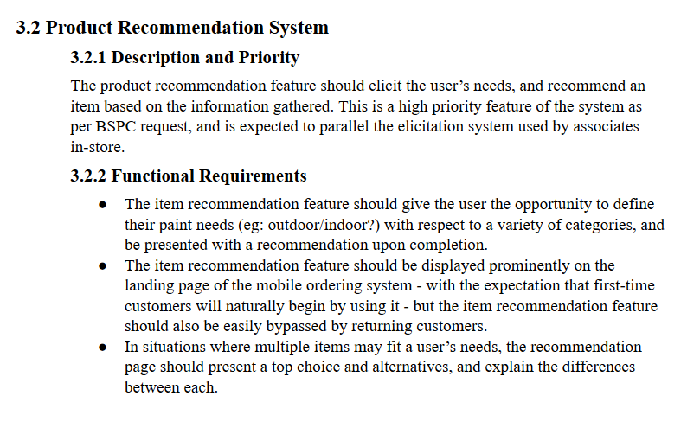
Notes:
The selection guide feature started with the RFP, from there we took their requirements and transformed them to a feature in the requirements document.
The RFP stated “the application must follow a linear path of questions for selecting products”
The first client elliciation provided us better context on the selection guide.
we determined that it should mimic the process employees follow in store when assisting customers.
I'll pass it off to our client to describe the instore process and what they expect from our applications selection guide.

Slide 22
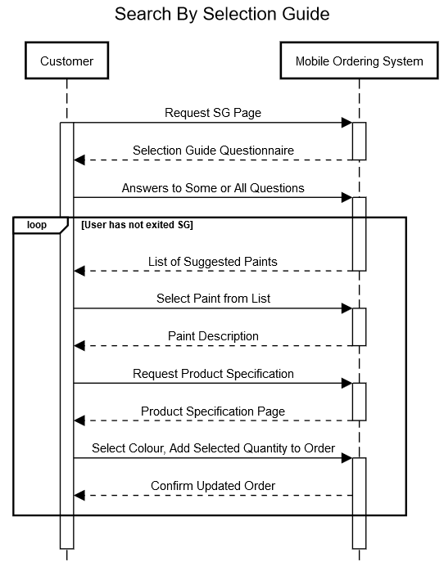
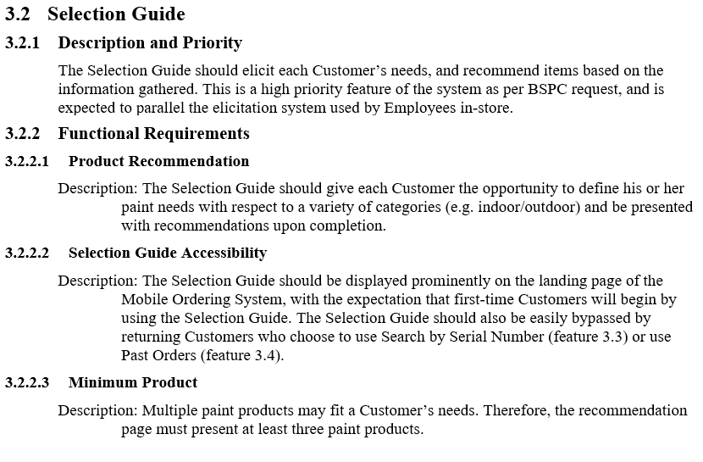
Notes:
Based off of client feedback the functional requirements were made to match their expectation.
We expanded the feature to specify that the user should answer all of the questions.
The selection guide must provide the user with at least 3 products to consider.
And that the selection guide be front and center in our application to improve new user experience
Creating the accompanying diagrams and use cases made us consider each point in the feature description in more detail

Slide 23
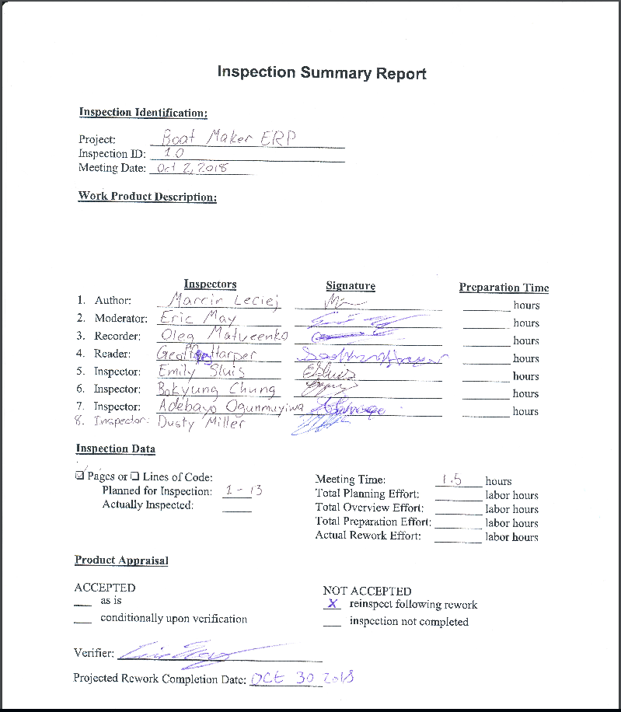
Document Revision Process
Document revision evolved with the document.
Verification and validation of the document content
Notes:
After reviewing an RD as clients using the inspection summary report we found the process to be very effective
Before finalizing the initial release of our RSD we performed the process on our document
Following the process and making individuals responsible for moderation, reading and recording streamlined our editing process and made our workflow more efficient.
The revision process assisted in validating the document by discussing the features as a group, it also assisted verifying the consistency and reducing ambiguity
Transitioning the workflow to a more teamwork oriented approach helped improve the document quality

Slide 24
Lessons Learned
Elicitation from client to specification
Group document revision
Selection Guide
Notes:
While the selection guide feature followed the regular RE path it was still an important learning experience.
it showed the importance of client communication and continuing two way discussion.
It also underwent many revisions using the group revision process, showing the power of teamwork organization.
I’m going to hand it off to Emily to talk more about teamwork.

Slide 25
Teamwork in the Workplace
Notes:
We began this semester with a strong, enthusiastic team but I don’t think any of us expected to completely flip the way we had worked as a team upside down. We started with quick meetings to divide tasks, working separately to complete them and then coming together to try to turn all the pieces into one cohesive document.
However, we found that this became a challenge, it was hard to be consistent in both the content and voice of our writing.
So we changed our meeting dynamic. We started having longer meetings, thoroughly discussing every aspect of our next deliverable to the point where tuesdays became argument, i mean, discussion days . We slide into roles naturally that fit our strengths, and different people in our group became resident experts on certain aspects. If there was a decision to be made, we ensured we had a group concensus before continuing.
Overall this lead to longer meetings, but when we split off to get things done, we were able to finish our pieces quickly and efficiently combine them into the final product. By spending more time planning, we spent less time working.
Before we wrap up, would the client like to add anything?
**Need transition to conclusion.
Natural ‘slide’ into roles
Specialization into roles
Meeting dynamic: short meeting at start, separation into tasks, recombining at end
Evolved into constant conversation between teammates to refine items
Each person had input on each part

Slide 26
All in All...

Slide 27
Whether you want to be involved in the process of RE or not, I think it’s an easy sell to say “I want to work in a place that does it.”

